Slide 1
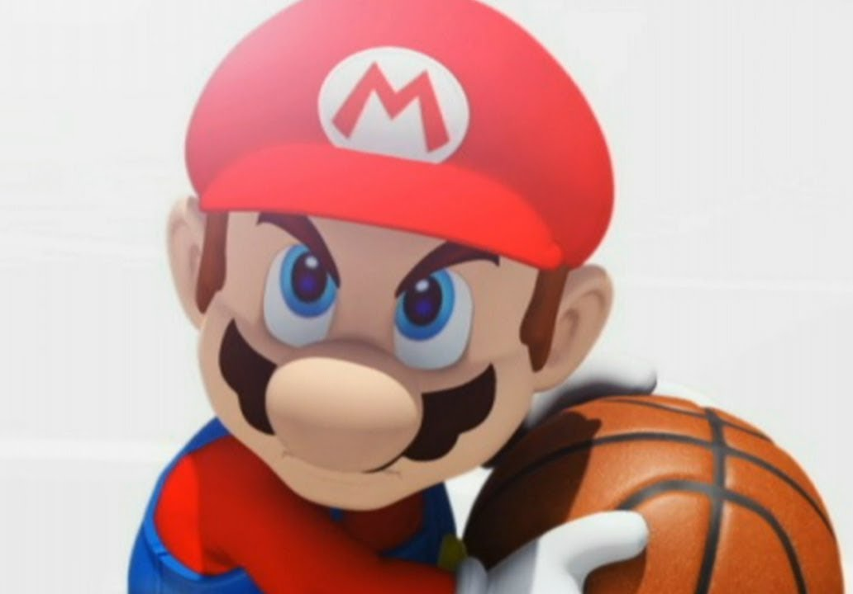

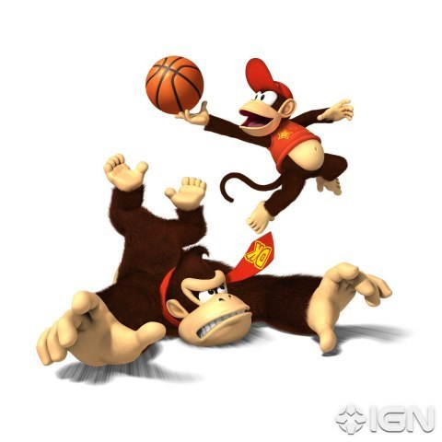
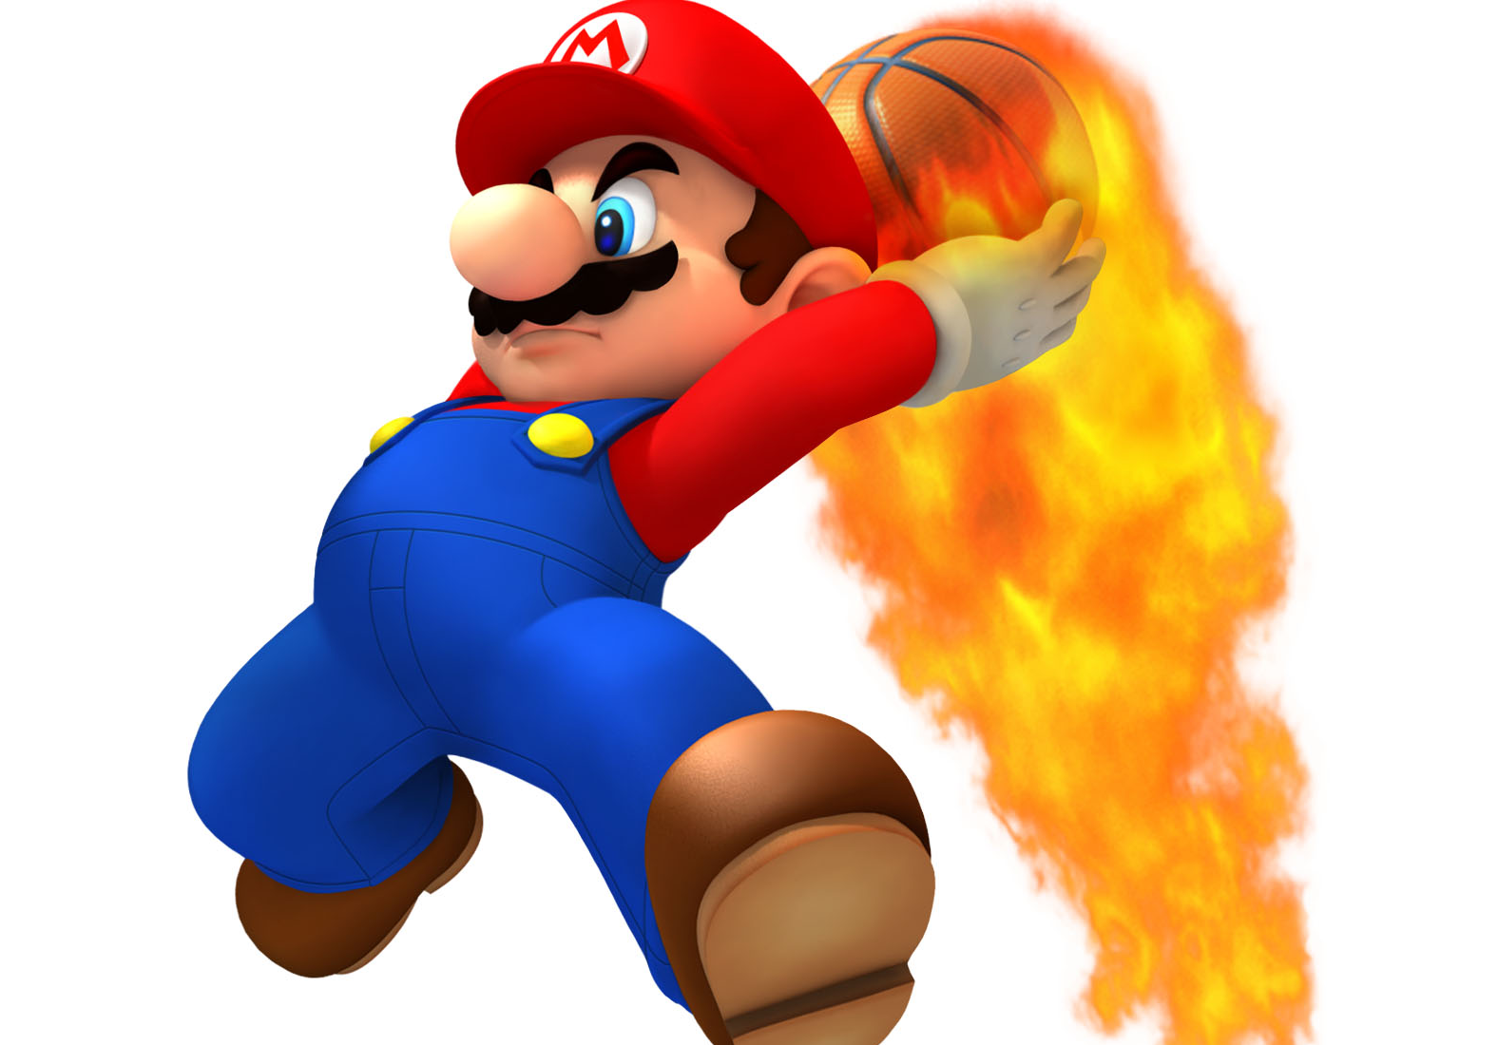
Basketball III
Produced by Dr. Mario
UNC STOR 538

Slide 2
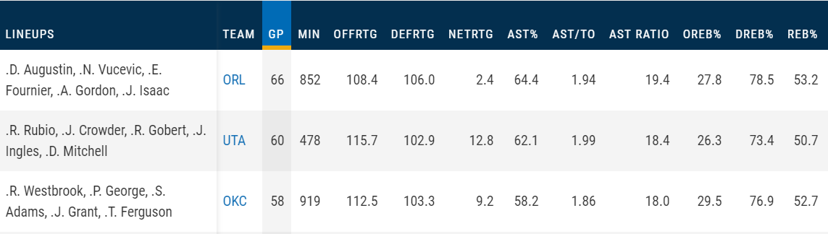
NBA Lineup Analysis
Facts About Lineups
Few Players on NBA Teams are Traded
Important Coach Decision: Lineups
What Players Should Play Together
What Players Should Play Against Opponents
Approximately 300-600 Unique Lineups in a Season
Statistics Measured on the Lineup (NBA.com)

Slide 3
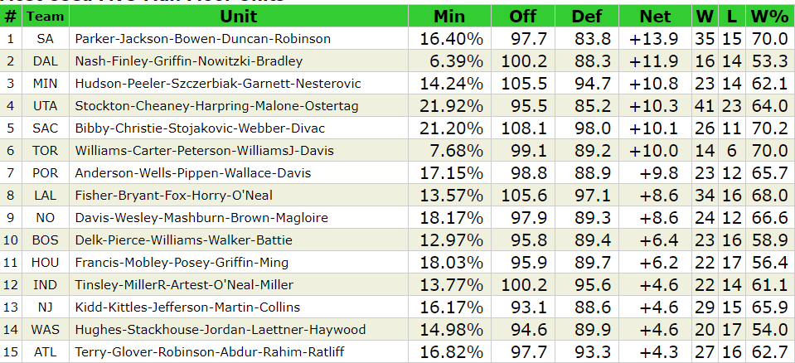
NBA Lineup Analysis
Statistics Measured on the Lineup (82games.com)

Slide 4

NBA Lineup Analysis
Example: Adjusted +/- for the NBA Lineup
Pacers Lineup A={JO,DG,JT,TM,MD} Played 326 Minutes
This is Equivalent to 6.79 Full Games
Outscored Opponents by 11 Points (Pure +/-)
Scaled to 48 Minutes
Lineup Played Against Opposition Lineups Averaging +1.89 Points Better Than Average Team
Pacers Lineup A has Adjusted +/- of 1.61+1.89=+3.5 Points Better Than Average Lineup
$$\frac{11}{6.79}=+1.61 Points Per 48 Minutes$$

Slide 5
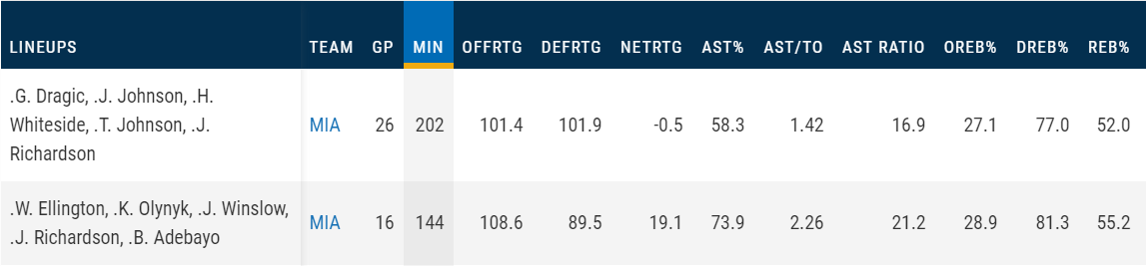
NBA Lineup Analysis
Examples of Poor Lineup Decision Making
Miami Heat (2017-2018)
Which Lineup Should Play More?

Slide 6

NBA Lineup Analysis
Problem’s With Lineup Analysis
Many Lineups Don’t Play Many Minutes (High Variability)
Less Than 10% of All Lineups Have More than 27 Offensive Possessions
Median Number of Possessions Across All Lineups = 6 Possessions
Superiority Hypothesis Testing
Null Hypothesis: Lineups are Equal
Alternative Hypothesis: Lineup 1 is Superior to Lineup 2
P-Value < 0.05: Indicates Lineup 1 Superior to Lineup 2
Estimate of Lineup’s Ability Above Average Team = Adjusted +/-
Standard Error of Estimate
$$σ=\frac{12}{\sqrt{Number of Games}}$$
Needs Justification

Slide 7
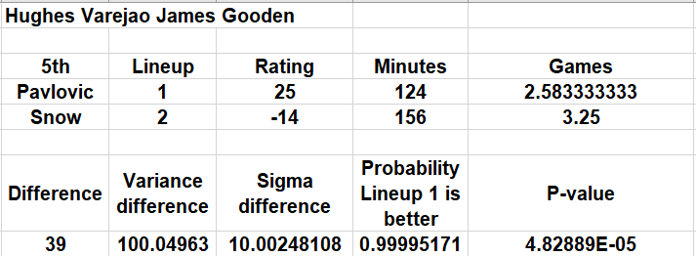

NBA Lineup Analysis
Example: Competing Cavs Lineups (2006-2007)
Lineup 1 {DG,LH,LJ,SP,AV} with Adjusted +/- of 25
Lineup 2 {DG,LH,LJ,ES,AV} with Adjusted +/- of -14
Lineup 1 Played 124 Minutes or 2.6 Games
Lineup 2 Played 156 Minutes or 3.3 Games
Question: Was Lineup 1 Significantly Better than Lineup 2?
$${\hat{σ}}^{2}=\frac{144}{2.58}+\frac{144}{3.25}$$
$$1−NORM.DIST(39,0,10.002,TRUE)$$

Slide 8
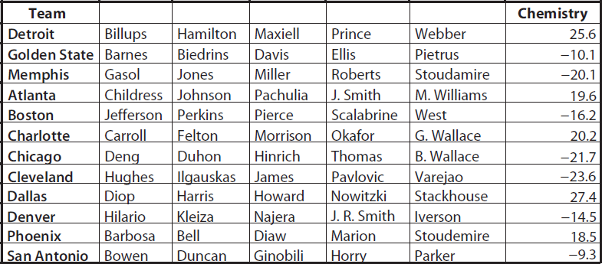

NBA Lineup Analysis
Lineup Chemistry
How Would You Define Good Chemistry?
Let LAPM Represent Lineup Adjusted +/- Rating
Let PAPM Represent Player Adjusted +/- Rating for Player
Example (2006-2007):
$$Chemistry=LAPM −\sum_{i=1}^{5}{PAPM_{i}}$$

Slide 9
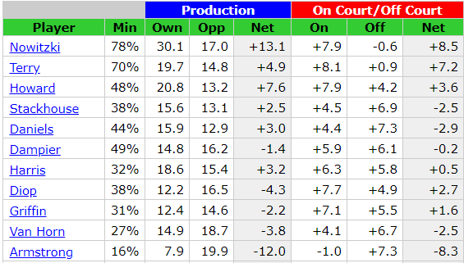
Team and Individual Matchups
Example of Coaching Decision
Spurs Versus Mavericks in 2006 Playoffs
Mavericks Beat Spurs in 7 Games
Replaced Adrian Griffin with Devin Harris
Mavericks’ Season Information

Slide 10
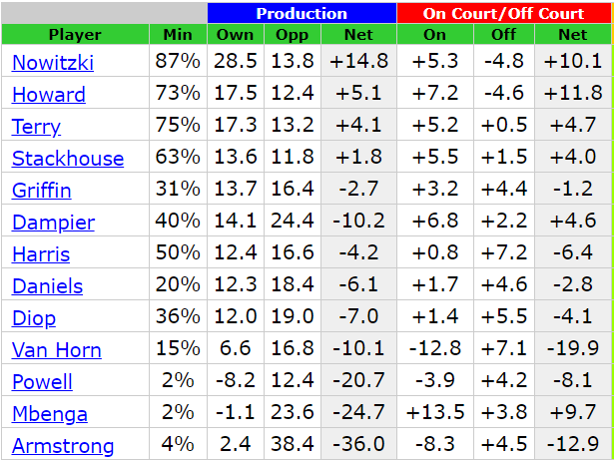
Team and Individual Matchups
Example of Coaching Decision
Mavericks’ Playoff Information

Slide 11
Team and Individual Matchups
Example of Coaching Decision
Why Was This a Good Decision?
Adrian Griffin Had a -18 Offensive WINVAL Which Means He Had a -23 Defensive WINVAL (Horrible Impact on the Mavericks’ Offense)
Statistics for Harris | Overall Season | Against Spurs
Adjusted +/- (WINVAL) | -2.1 | +9.4
Impact Rating | -15% | +8%
Statistics for Griffin | Overall Season | Against Spurs
Adjusted +/- (WINVAL) | NA | -5.0
Impact Rating | NA | -18%

Slide 12
Team and Individual Matchups
2-Way Lineup Calculator
Summarizes Result of Any Combination of Team’s Players On or Off the Court Versus Any Combination of Opponent’s Players On or Off the Court
Calculation For Mavericks and Spurs Indicated Devin Harris Could Outperform Tony Parker
Result in Spurs and Mavericks Playoff Series
Harris and Parker On Court = 2 Points Over Spurs
Harris Off Court and Parker On Court = 15 Points Under Spurs

Slide 13
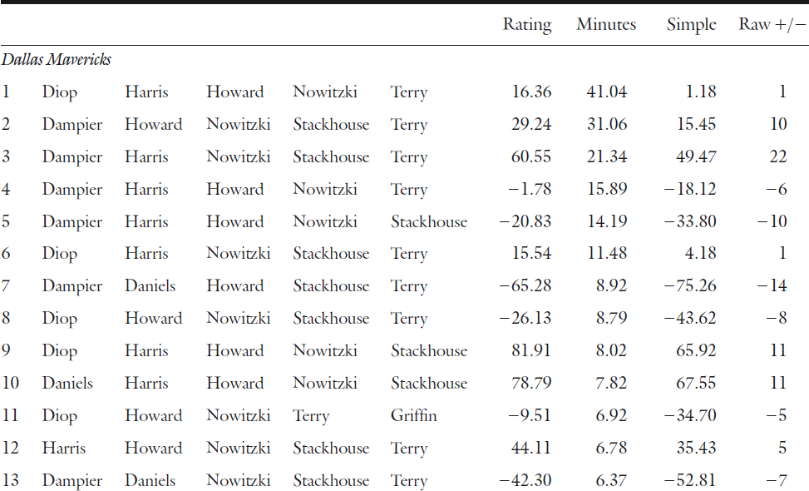
Team and Individual Matchups
Lineup Calculation for the Mavericks in Playoffs

Slide 14
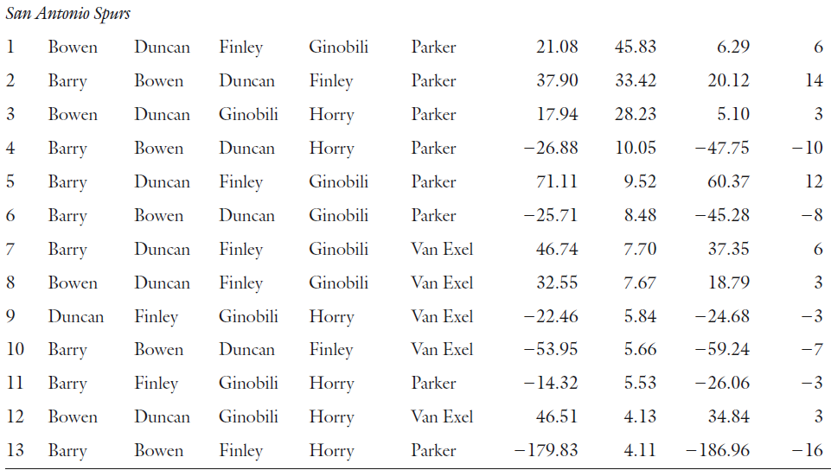
Team and Individual Matchups
Lineup Calculation for the Mavericks in Playoffs

Slide 15
Team and Individual Matchups
Non-Transitivity of NBA Matchups
What is Transitivity?
Player A > Player B
Player B > Player C
Then, Player A > Player C
Be Careful Not To Assume Transitive Property in Sports
Example in 2005-2006 Season
Devin Harris > Tony Parker
Devin Harris + Jason Terry Against Steve Nash (-23 Points)
Jerry Stackhouse + Jason Terry Against Steve Nash (+20 Points)
Steve Nash > Devin Harris
Does This Imply, Steve Nash > Tony Parker
Across Season, Steve Nash Impact was +28%
Against Spurs, Steve Nash Impact was 0%
Across Season, Tony Parker Impact was -3%
Against Suns, Tony Parker Impact was +35%

Slide 16

Final Inspiration
If you are going to foul, foul hard.
- My Father

